Slide 1


Effect of radius on interpolation

Slide 2
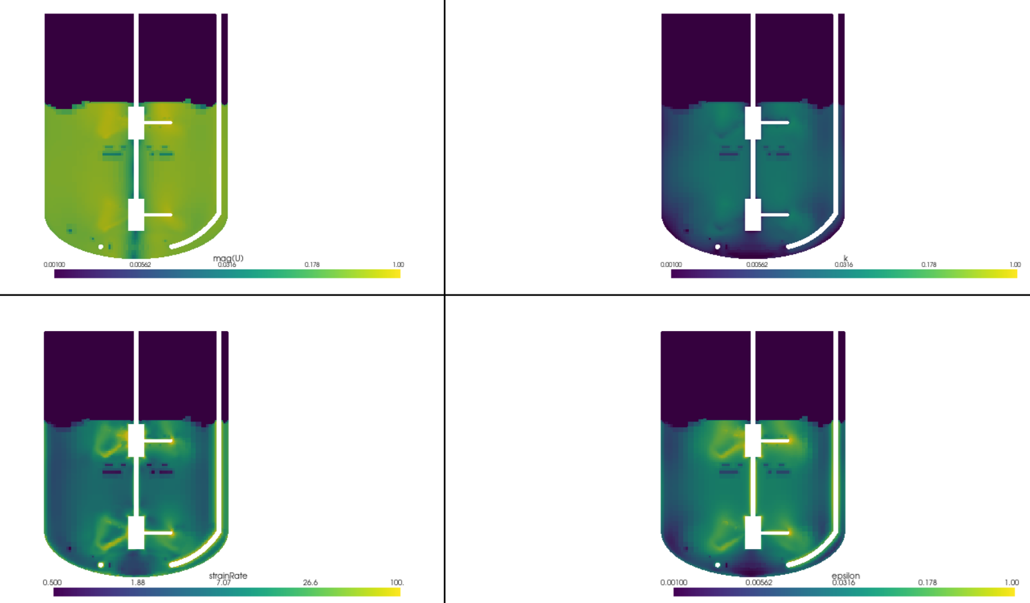

Radius =0.001

Slide 3
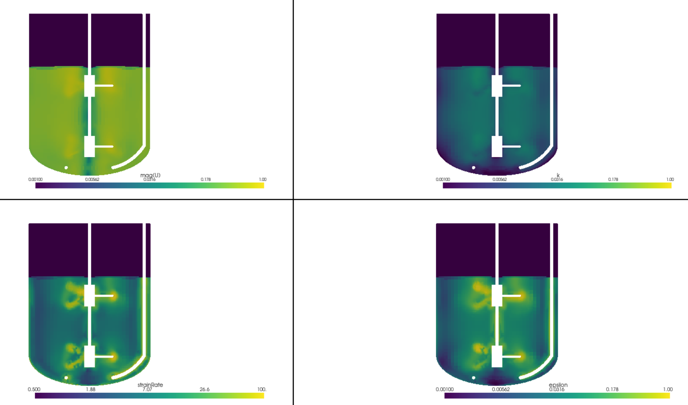
Radius =0.0155

Slide 4
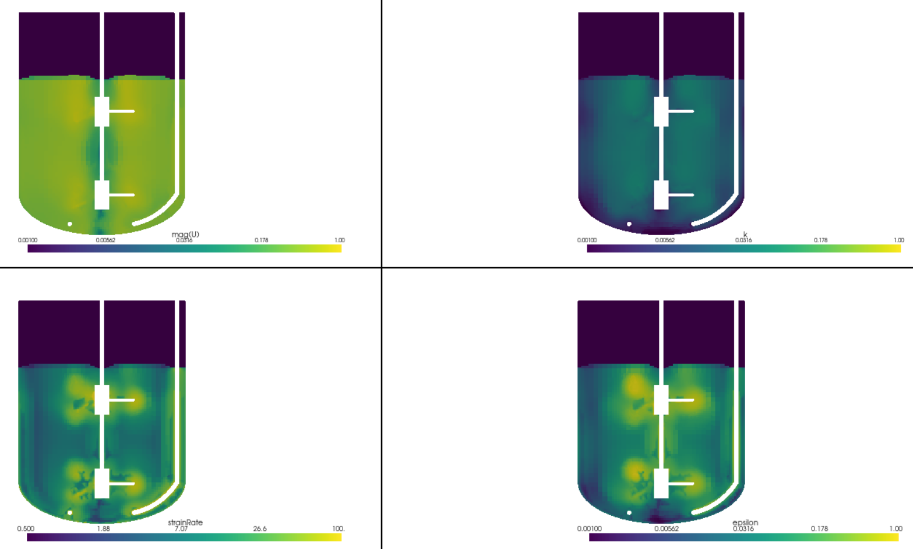
Radius =0.0311

Slide 5
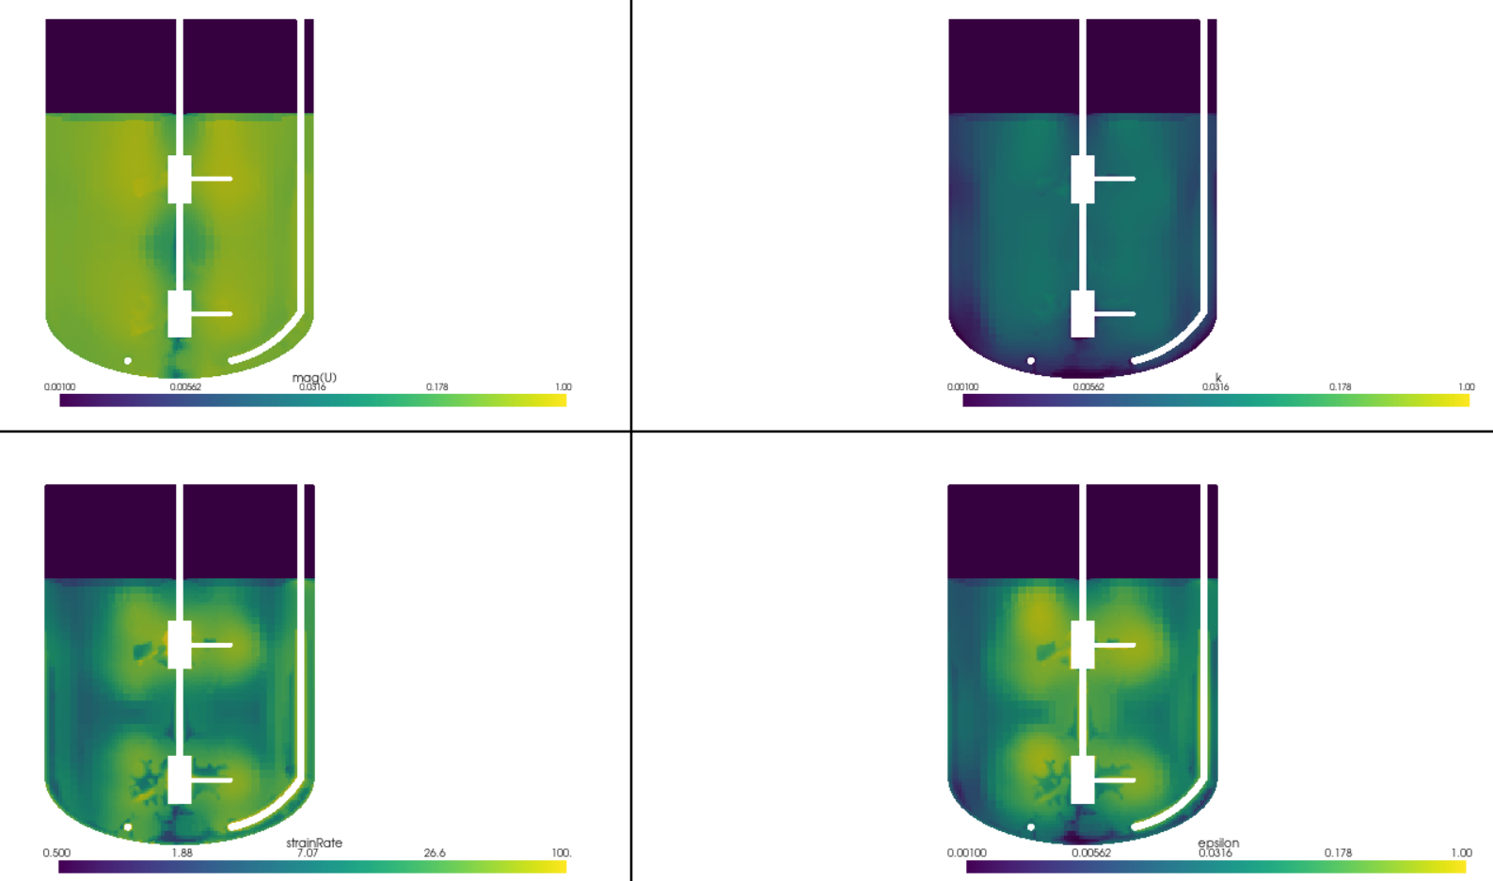
Radius =0.005

Slide 6
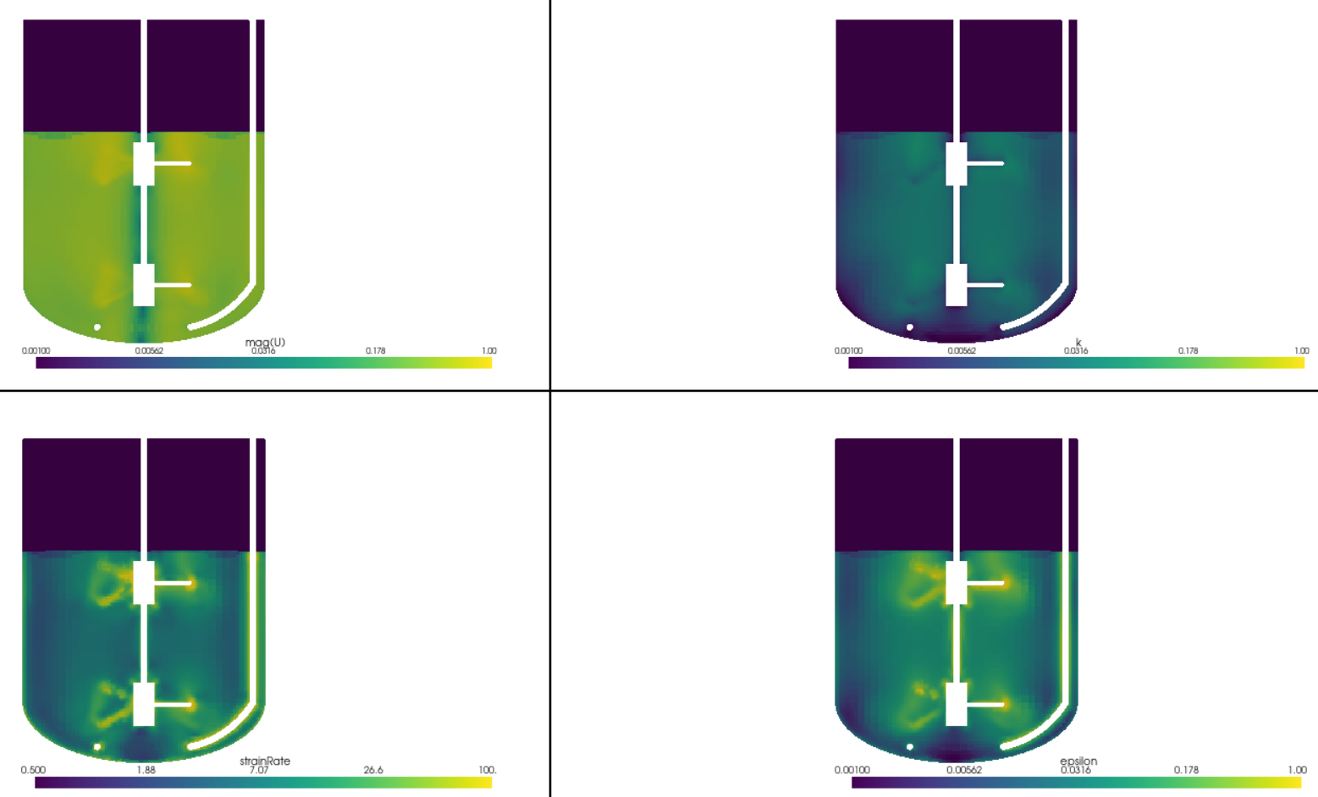
Radius =0.008

Slide 7
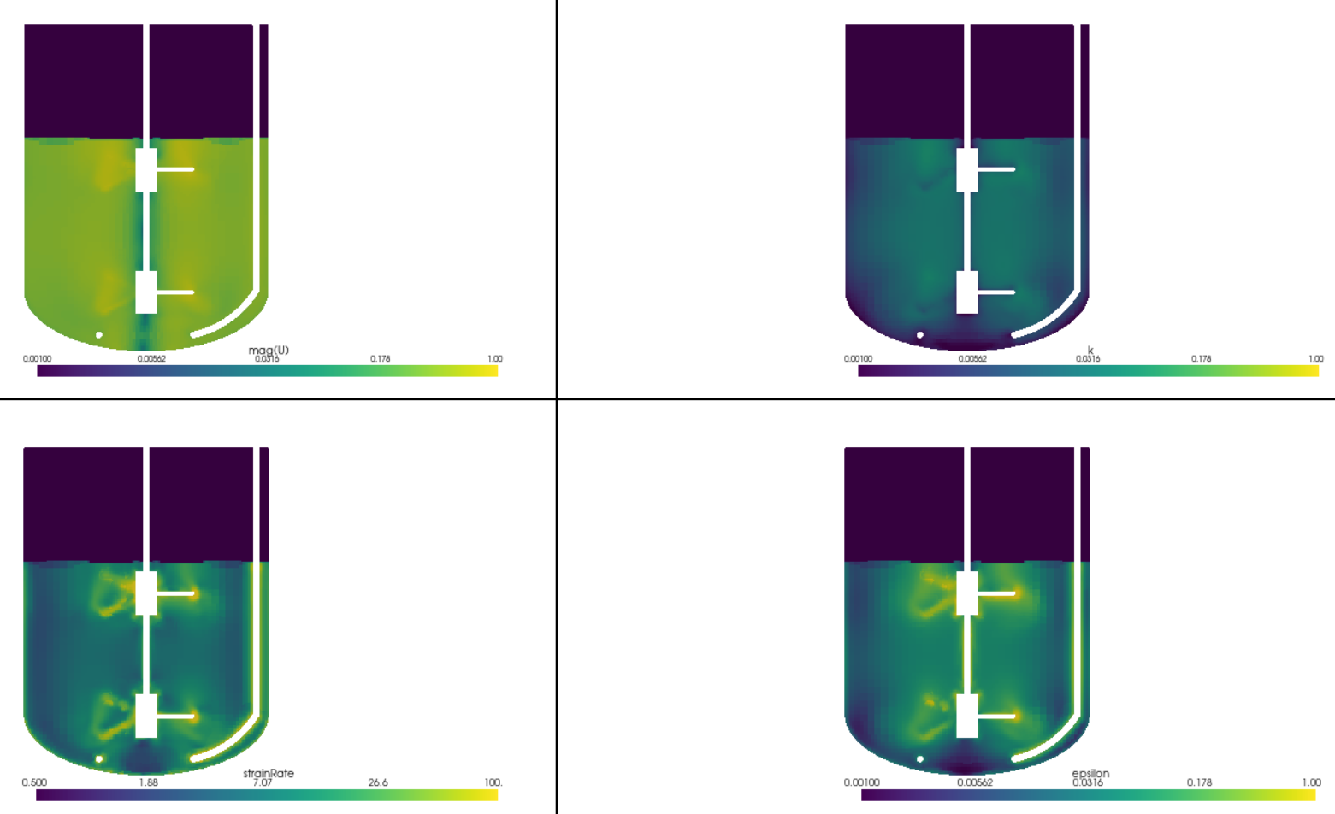
Radius =0.0075

Slide 8
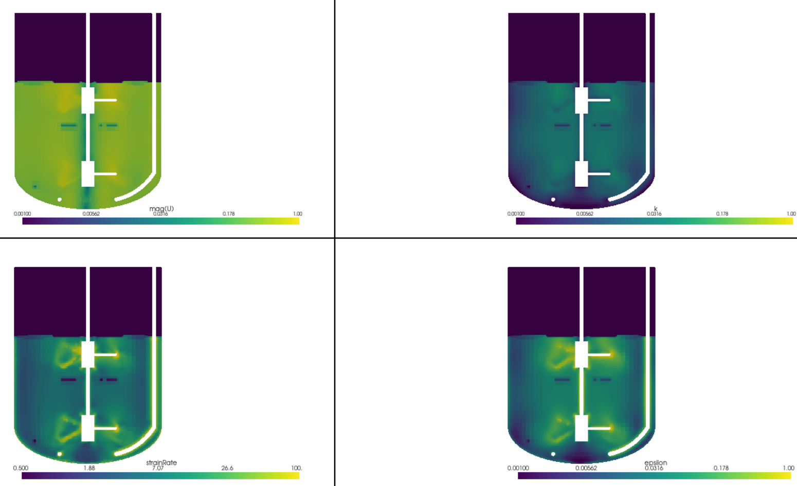
Radius =0.005

Slide 9
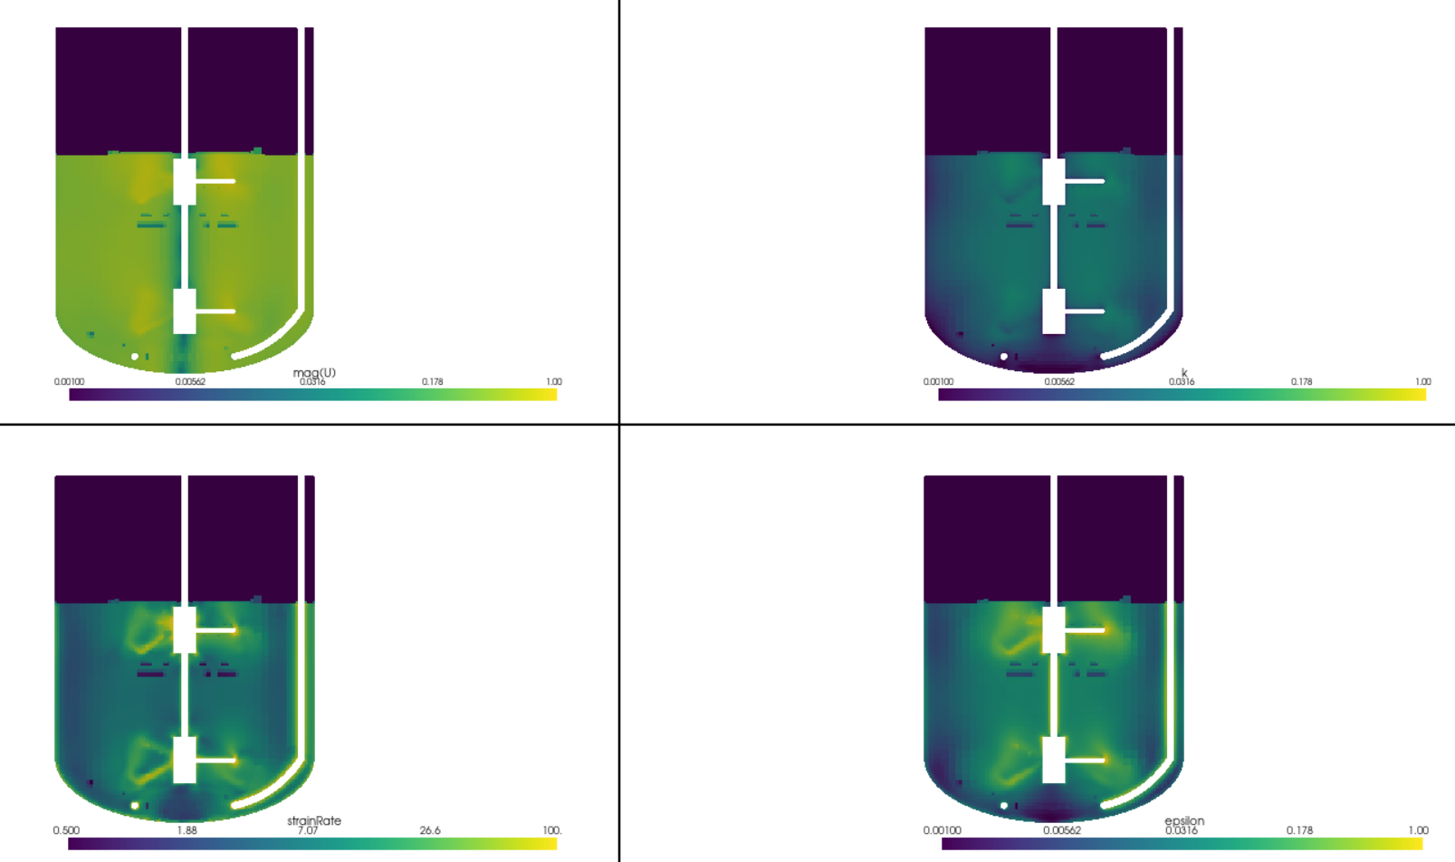

After superimposing with radius =0.001

